Slide 1


Introduction to IDPF & EPUB
O’Reilly TOC
February 14, 2011
Speaker George Kerscher
Notes:
I will take a couple of minutes to make you aware of one such developments in eBook space called EPUB,.
We will also discuss the value of a Standardized format as well as recent news providing strong indications about commitment to eBook space from Significant Players in eBook Industry.
The International Digital Publishing Forum is focused on the helping to grow the Digital Publishing Space and has created and maintains EPUB the eBook standard for Digital Reflowable text.
Right now, EPUB is going through an adoption phase happening on a variety of fronts.
Publishers, Software Developers, Distributors, Device Manufactures, Digital Rights Management Companies, are all planning forward
with a strong reliance on EPUB.

Slide 2
What is IDPF?
Not for profit Trade and Standards organization with over 175 members from 25+ countries.
All working together to advance Digital Publishing Ecosystem
Responsible for EPUB Standard
Notes:
publishers, nonprofits, and HW/SW/ services providers

Slide 3

What is EPUB?
EPUB is the interchange & delivery format for digital publications based on Web Standards
EPUB enables structured, accessible content, interoperable between devices & applications, for downloaded and online consumption
Standard developed by IDPF since 1999
(OEBPS 1.x became EPUB 2.0 in 2007)
EPUB = XHTML content with navigational structure & metadata, in a ZIP-based package

Slide 4
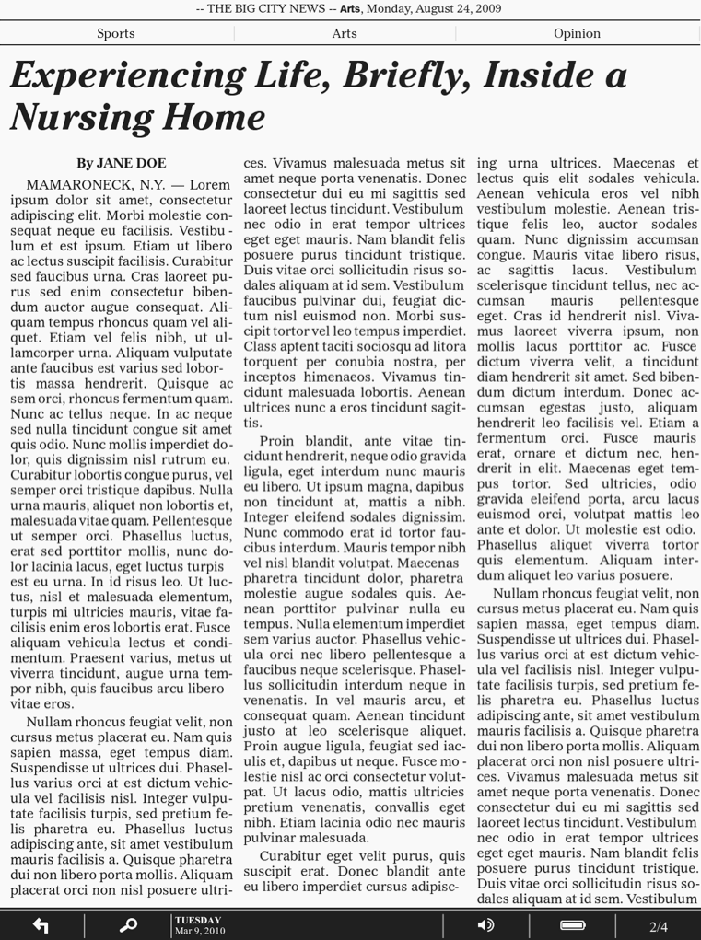
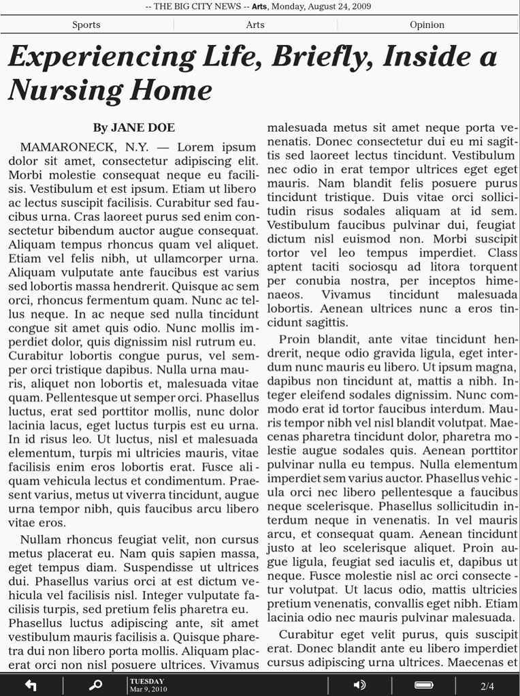
EPUB Emphasis: Dynamic Layout
Content paginated “on the fly” based on screen size, user font size preference “fixed” layouts.

Slide 5
EPUB Industry Adoption Timeline
2010
- Apple iBooks
- 25+ eReaders
- 25+ smartphone apps
- Most Kindle sales from titles ingested as EPUB
- EPUB3 chartered
2009
- Google: 1M PD EPUBs
- Sony store to EPUB
- B&N Nook
2008
- AAP endorses
- UK PA endorses
2007
- EPUB standardized
- Adobe Digital Editions
- Adobe InDesign
- Sony Reader
Notes:
Success with EPUB has been fantastic but we knew we needed to take it further…

Slide 6
EPUB 3
  Working Group chartered May 2010 with ambitious goals
    Expand EPUB applicability for global content
    Improvement for complex, interactive, media-rich titles
      Textbooks, STM, magazines
    Increase Web Standards alignment (HTML5)
    Improve EPUB conformance & accessibility
    Public draft due out soon, very soon
  EPUB 3 is on track to be approved by May 2011
Notes:
The main reason we are on track is that we are building on already adopted Web Standards like HTML5, CSS3 Modules, MathML, etc.

Slide 7
EPUB 3: General Enhancements
  Core content based on XHTML5
  Enhanced global language support
  Styling & layout enhancements
  Improved metadata capabilities
  MathML support
Notes:
Full convergence with DAISY to be the unified format for accessible publications
Core content based on XHTML5
Optional scripting support for interactivity
Enhanced global language support
Vertical writing, Ruby, page-progression, …
Styling & layout enhancements
CSS3 Multi-column, Media Queries, Hyphenation
Improved metadata capabilities
Table of contents now XHTML-based microformat
MathML support
Extension mechanism for new content types (JS)
Cross-document linking support (fragment ID’s)

Slide 8
EPUB 3: Rich Media Enhancements
  Video & audio support
  Audio can be synchronized with text
  Embedded font support a baseline requirement
  Improved SVG support
Notes:
Declarative event triggers (custom controls w/out JavaScript)
MP3 audio and H.264 video required for Reading Systems

Slide 9
Accessibility Features in EPUB 3
DAISY Navigation (was NCX) EPUB Navigation is a MUST for both content and reading systems
EPUB will support Audio and Text Synchronization using simple SMIL
Semantics from DAISY Authoring and Interchange preserved

Slide 10
Accessibility Features in EPUB 3
Publishing domains require semantics not present in HTML 5
More semantics is better for Everybody
Books, newspapers, journals have their own specific semantics
We can provide a "semantic inflection" to HTML elements by using an attribute
Example: footnotes and footnote references
Semantic inflections through attributes provide an extensible rich mechanism to add semantics

Slide 11
Summary
EPUB has rapidly become established as the eBook format standard in North America and Europe
EPUB 3 with enhanced global language support has a promising future worldwide.
  EPUB = reliable “package” for Web content
  Leveraging Web standards is a huge win for ecosystem
EPUB 3 will deliver HTML5 support, rich media & interactivity, formatting improvements, enhanced accessibility and other key new capabilities

Slide 12
For More Information
IDPF website: http://idpf.org
EPUB 3 Working Group site:
http://code.google.com/p/epub-revision

